Slide 1
Business Perspective
Lecture 5

Slide 2
Today’s topics
Different types of analytics
Ethical considerations
Challenges with data
Data roles
Describe visuals
Break
Data querying
Data visualization

Slide 3
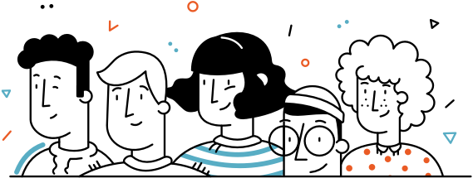
Different Analytics

Slide 4
Descriptive Analytics
Looks at data to examine, understand, and describe something that has already happened.
Looks at events in the past → Identify specific patterns
Commonly used visuals: pie charts, bar charts, tables, line graphs
Example:
How many sales occurred in the last quarter?

Slide 5
Diagnostic Analytics
Provides a deeper analytics by seeking to understand the “why” behind what happened.
You must first understand what happened to be able to analyze what will happen.
Example:
Why did sales drop in January of last year?

Slide 6
Predictive Analytics
Relies on historical data, past trends, and assumptions to answer questions about what is likely to happen in the future.
Techniques:
Regression analysis, forecasting, multivariate statistics, predictive modeling
Requirements for these techniques are large amounts of high-quality and historic data. They are also done using programming such as R and Python.
Example:
How will the next marketing campaign impact the customer engagement?

Slide 7
Prescriptive Analytics
Identifies specific actions an individual or organization should take to reach future targets or goals.
Techniques:
Graph analysis, simulation, neural networks, machine learning
This is one of the most advanced level of analytics and it heavily depends on the accuracy of the descriptive, diagnostic, and predictive analysis. It also heavily relies on quality of data and the appropriate data architecture and expertise.
Organization will be able to make decisions based on highly analyzed facts rather than instinct.

Slide 8
Analytics in decision making
Analytics
Human input
Data
Descriptive
Decision
Action
Diagnostics
Predictive
Prescriptive

Slide 9
Cognitive Analytics
Cognitive analytics is an advanced type of analytics that uses artificial intelligence and machine learning to identify patterns and trends in large sets of data.
It can be used to uncover insights that may not have been visible before, and to create predictive models that can help organizations make better decisions. Organizations are using cognitive analytics to tap into unstructured data sources such as images, emails, text documents, and social posts.
Examples:
Apple’s Siri, Samsung’s Bixby

Slide 10

Ethical considerations

Slide 11
Data Collection
Informed consent
All subjects have to be clearly informed on how the data is to be used. Based on this information they have to clearly give consent.
Collection bias
Bias at the collection stage means that the data gathered is not truly representative of the situation you are trying to investigate.
Personally identifiable information (PII)
Have to find ways to minimize the exposure of personally identifiable information for example through anonymization. Always keep GDPR in mind!

Slide 12
Data Storage
Data security
A plan to protect and secure data, such as encryption, access controls, etc.
Right to be forgotten
The subjects have to have the right request their personal information to be removed
Data retention plan
Does the data have to be deleted after it is no longer needed?

Slide 13
Analysis
Missing perspective
Could the analysis have missing perspective? How can we address this?
Privacy
Are PII sensitive data have been removed/addressed in the data before analysing/visualizing?
Auditability
Is the analysis well-documented and can be reproduced later if needed?

Slide 14

Challenges with data

Slide 15
Meaningful data
Multiple sources
Companies are now data-driven = lots of data → hard to find insights in a lots of data.
It’s impossible to sort and analyze all the data in real-time, which might fail to provide accurate and relevant reports. To make it easy, using appropriate data analytics tools are important.
The various sources are not necessary the same format or they are hard to join
Employees may not know that the data they need are not in the same source

Slide 16
Scaling
Data culture
Data security
With the rapidly increasing data volume, businesses face the challenge of scaling data analysis. Also, one might find that the software tool is not scalable.
Most companies are not data-driven and employees do not know much of DA.
Inaccurate data (usually manual/human errors)
Often changes in one system don’t reflect in another system
Increase in data volume also increases data storage, and that calls for security measures that minimize cyber risks.

Slide 17
Data roles

Slide 18
Data Analyst
“Data Analyst analyzes numeric data and uses it to help companies make better decisions.”
Responsibilities
Pre-processing and data gathering
Representing data via reporting and visualization
Statistical analysis and data interpretation
Data maintenance
Communication with stakeholders

Slide 19
Data Scientist
“A data scientist analyzes and interpret complex data. They are data wranglers who organize (big) data.”
Responsibilities
Data analytics and optimization using machine learning and deep learning
Strategic planning for data analytics
Statistical analysis and data interpretation

Slide 20

Data Engineer
“Data Engineer involves in preparing data. They develop, constructs, tests & maintain complete architecture.”
Responsibilities
Develop, test, and maintain architectures
Deploy machine learning and statistical models
Building pipelines
Creating ETL/ELT operations

Slide 21
Describe Visuals

Slide 22
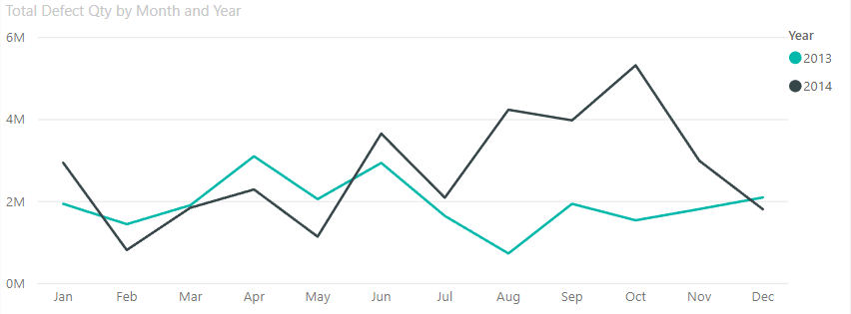
Notes:
This chart is a depiction of defect products over two years in a factory. Students should write a text talking about the general characteristics of this visual.

Slide 23
In 2013, April and June were the months with the highest amount of defect products. However, 2014 saw an increase in defective products overall, with December being the month with the most. There were also three noteworthy drops in the amount of defect products in both years: between June and August in 2013 and between January and February, as well as between October and December in 2014.
[Here, if you know the underlying reason, you can explain it]

Slide 24
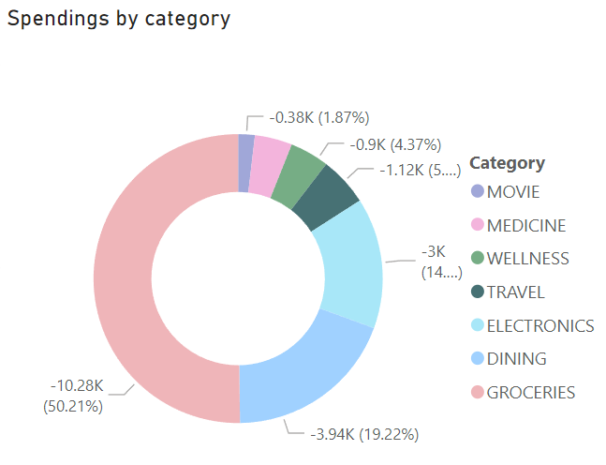
Notes:
This is a family’s spending habits in a quarter. After identifying the category with the most spending, students should formulate a text in the realms of “Financial advice for a family of three, who is looking into saving more” They should also be able to tell why this visual is not ideal, and what other type would be better, for example a bar chart.

Slide 25
We can see that over half (50.21%) of this family’s income is spent on Groceries in a quarter, followed by Dining with almost 20% and Electronics with a lower percentage. To maximize their savings, we suggest reducing spending in these three categories.

Slide 26
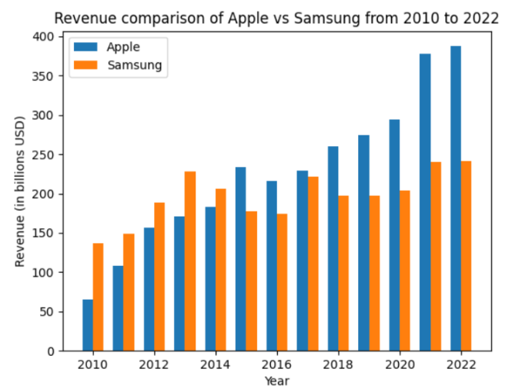
Notes:
The chart speaks for itself ;)

Slide 27
This visuals shows the revenue of Samsung and Apple between 2010 and 2022. We can see that from the beginning of the decade until 2014 Samsung’s revenue was higher than that of Apple, which later on changed to the benefit of Apple.
In 2010, Samsung’s revenue was double of Apples and the closest their revenue has ever been was in 2017.
Notes:
If there is some time to spare, the teacher can decide to either jump right into the exercises or talk a bit about ChatGPT.

Slide 28
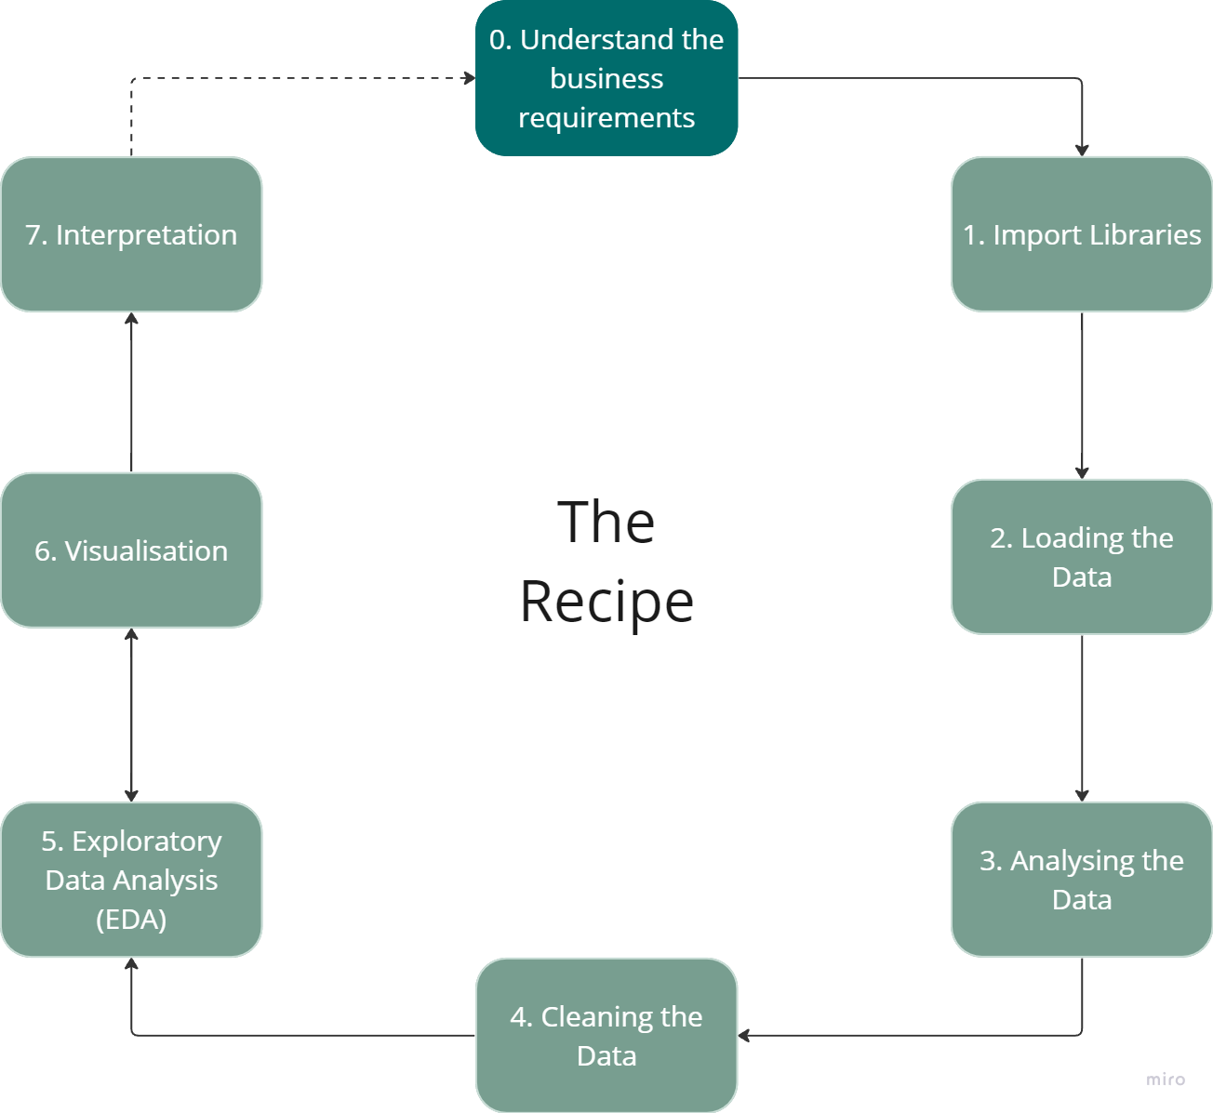
The recipe for data analysis

Slide 29
After the break, it is exercise time!

